Slide 1

Do winter cover crops suppress weeds in Midwestern corn- and soybean-based systems? A meta-analysis
Andrea Basche¹, David Weisberger², Virginia Nichols², Alisha Bower³, Chris Wilbeck³, Sarah Carlson³
1. University of Nebraska-Lincoln, Department of Agronomy and Horticulture, Lincoln, NE
2. Iowa State University, Department of Agronomy, Ames, IA
3. Practical Farmers of Iowa, Ames, IA

Slide 2
Project background and rationale
Focusing on the Corn Belt because of its high production, predominance of annual cropland and opportunity for increased cover crop adoption and for cost savings
Criteria: Conducted in Midwestern Corn Belt states*, measured weed density or biomass, included a fall planted cover crop before corn or soybean
Located 29 potential studies (out of 665 screened) and have included 15 studies in a database for this preliminary analysis
*Illinois, Indiana, Iowa, Kansas, Michigan, Minnesota, Missouri, Nebraska, North Dakota, Ohio, South Dakota, and Wisconsin
Notes:
Midwestern Corn Belt is different than edges of it in SE or MidAtlantic states – we grow corn and beans (will look more at NASS data to see what % of the states are growing c/s).
Fall planted only: window for cc’s that is most likely to advance
We think this is a super important question for our region / environment – major reason is the limited heat units – so what can cover crops do based on what the data says – the only way to make it pay is to offset herbicide costs – hypothesize that we can cut costs.
Recent paper came out - explain
This is a call to action – farmers are seeing this anecdotally but much of the research is showing up
Are pre emergence / or post emergence residual herbicides less effective? Were weed increases a result of a particular herbicide system.
Farmers also say that see increased weeds. – Sarah
Maybe a more favorable seed bed for weeds
Tillage could explain more weeds – turning over more seed weeds / increase weed germination
Mowing could also be responsible for a more favorable seed bed – maybe DeBruin mowed too early
Here’s what we need to address

Slide 3
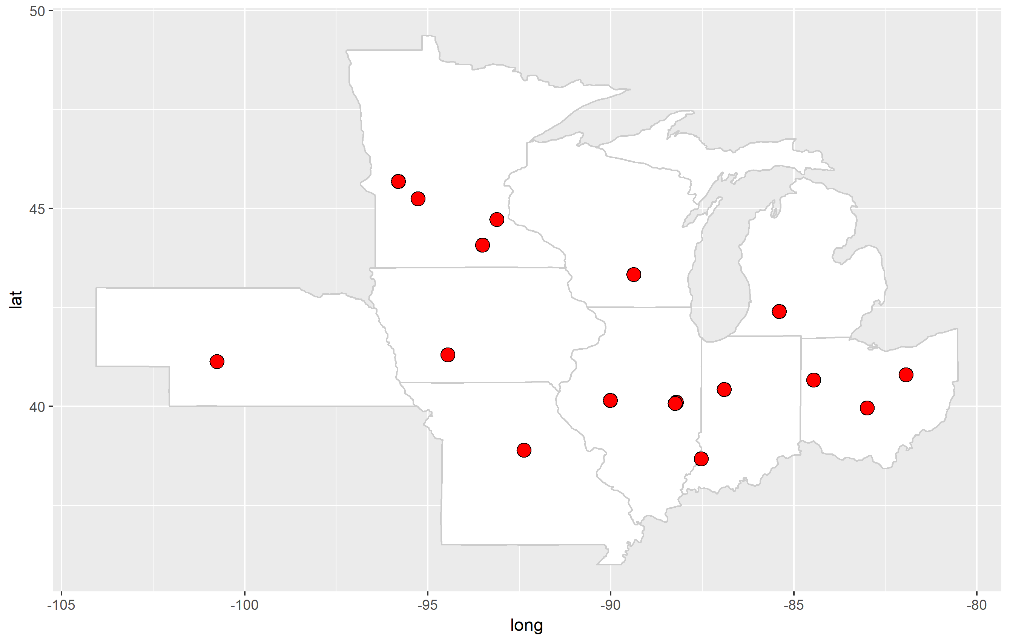

Slide 4
Procedure for building the database
Extract data systematically
Create a ratio of weeds:
weed density or weed biomass w/ cover crop / weeds w/ out a cover crop
LRR =
All treatments are equal other than the inclusion of cover crop
Total of 172 RRs from 15 studies analyzed to date
Different treatments (generally) lead to multiple RRs in each study such as termination method, cover crop species, planting dates, etc.

Slide 5
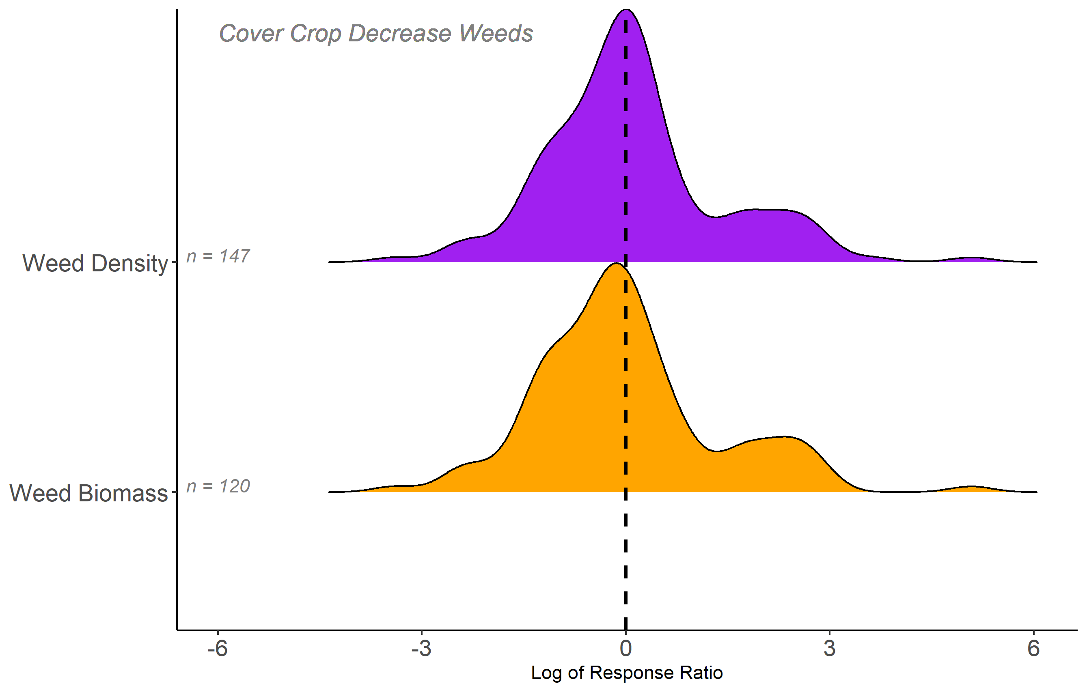
48% of RRs decrease weeds
55% of RRs decrease weeds
Notes:
What do we have to do to get the other half – glass is half full
Put the equation on this slide
How would density plot look diff if separated by crop – if its just soybean then it could be explained by heat units
Could be about germination timing of weeds

Slide 6
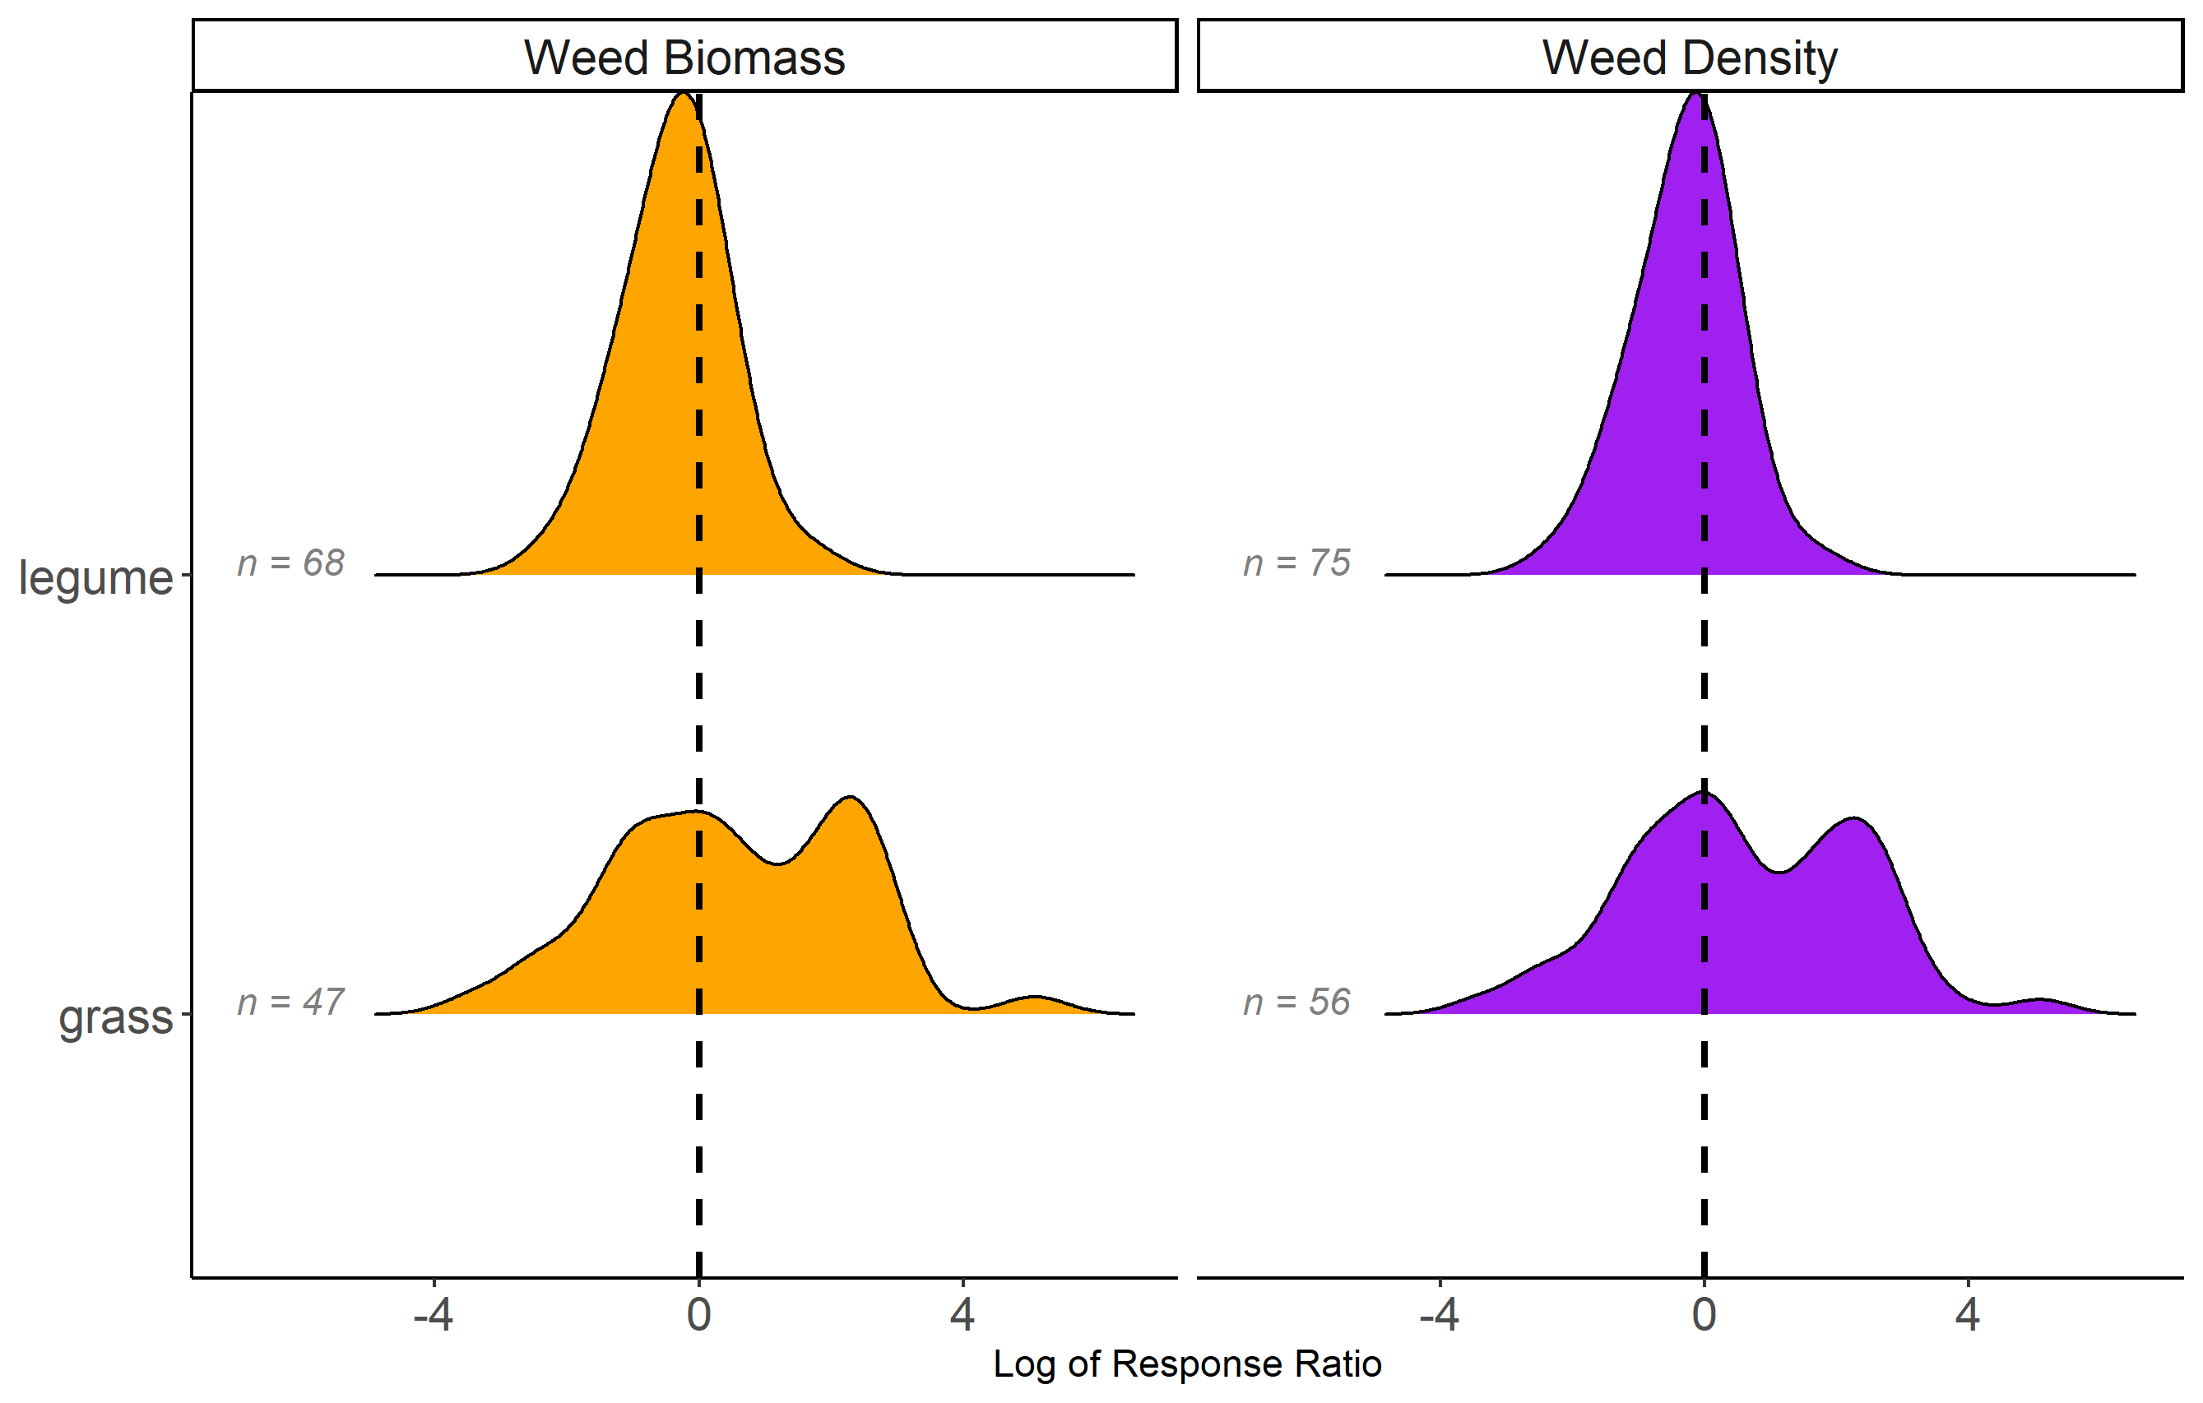
????
Visit our poster to find out which cover crop species is which! And more!
????
Notes:
MYSTERY GRAPH! I might even insert a polling question here
David’s suggestion is to include the win-win plot here – Sarah thinks the win-win plot would show that its all soybean

Slide 7
Summary
There were more studies that showed neutral to slight reduction in weeds w/ cover crops
Many open questions that need more research
What is in the win-win?
What is in the lose-lose?
Visit Poster 1137 to learn more from 4-6pm this afternoon!
We explore termination methods, biomass, following crop, etc.

Slide 8
EXTRA SLIDES FOR NOW
Note that their template is horrible and defaults to the 2017 logo beyond the third slide which is infuriating

Slide 9
State | Year | Cover crop species | Corn or soybean | Authors
OH | 1993 | vetch | corn | Hoffman et al.
MI | 2001 | clover, medic | corn | Fisk et al.
IL | 2002 | vetch | corn | Czapar et al.
OH | 2003 | wheat, vetch | corn, soybean | Gallagher et al.
MN | 2005 | rye | soybean | DeBruin et al.
IL | 2010 | rye, vetch | soybean | Davis et al.
WI | 2011 | rye | soybean | Bernstein et al.
IA | 2012 | mixes | corn, soybean | Delate et al.
MI | 2012 | rye/vetch, vetch | …* | Hayden et al.
IN | 2012 | wheat, ryegrass | corn, soybean | Mock et al.
MN | 2013 | rye | soybean | Forcella et al.
MN | 2016 | radish | corn | Gieske et al.
MO | 2017 | mixes* | soybean | Cornelius and Bradley
IL | 2017 | radish, canola, rye | soybean | Crawford et al.
NE | 2018 | rye | …* | Werle et al.
Notes:
PROBABLY WILL NOT SHOW THIS IN THE PRESENTATION BUT INCLUDING HERE FOR NOW – I PLAN TO INCLUDE THIS IN THE POSTER

Slide 10
